Slide 1
EPGP
Experimental Power
Graphing Program
USER GUIDE
Prepared by:
Dr. Ricaro V. Nunes, Universidade Estadual do Oeste do Parana
Dr. Gene M. Pesti, University of Georgia
Version 2.0

Slide 2


Slide 3
^{❶}Spreadsheet:
Home
^{❻}Example of Several Means
^{❷}Spreadsheet: Introduction
^{❸}Spreadsheet:
Calculation of Test Power
^{❹}Spreadsheet: Inputs & Constant Variance
^{❺}Spreadsheet: Constant CV

Slide 4
Introduction
Determining experimental power for planning purposes is, by its very nature, a risky business. Experiments are planned because we don't know what the results will be! We hope that the means and variances of control and treated groups will be similar to previous experiments, but that can't be assumed. There is always the possibility that any imposed treatments will affect individuals differently, changing the variation between treatment groups.
Sometimes the data is not "normally" distributed, for example, frequency distributions do not resemble bell-shaped curves. To analyze non-normal data, some transformation is needed to make it appear normal. QQ Plots may be helpful to see if a given transformation will make the data more "normal" and improve the accuracy of probability estimates using analyses of variance. You can use the workbook QPDOL.exe to check if your data would benefit from some transformation to appear more normally distributed.

Slide 5
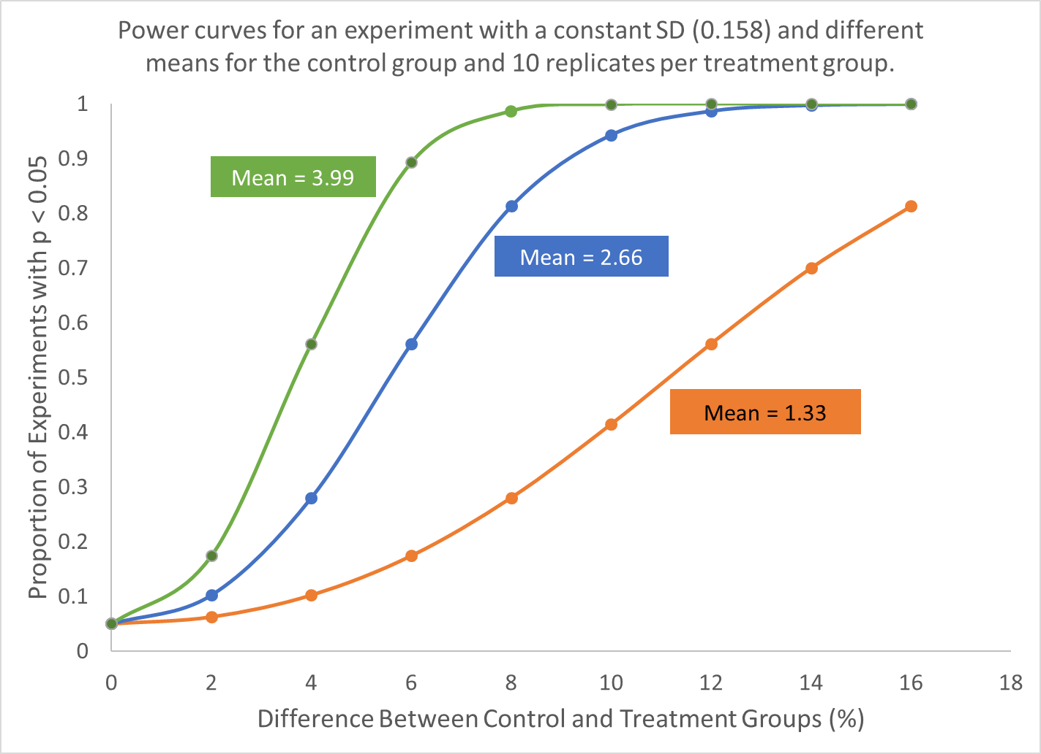
Introduction
When estimating experimental power, it is important to know the variation expected in the results. It is just as important to know the mean of the control or normal reference group. The example in the graph below shows how important it is to know both the mean and standard error when estimating experimental power.
For planning purposes, it may be best to use the expected mean of the control or reference group. Then the estimated power will be for differences from that mean.

Slide 6
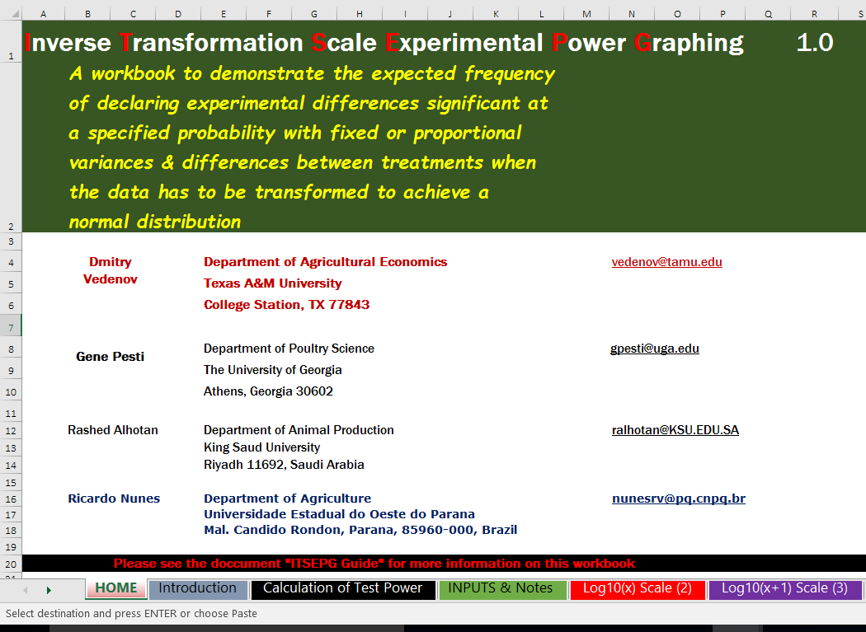
Important
IF THE TARGET MEAN AND TARGET STANDARD DEVIATION WERE DERIVED FROM TRANSFORMED DATA, THEN THE EXPERIMENTAL POWER SHOULD BE ESTIMATED FROM THE INVERSE TRANSFORMED SCALES FOUND ON THE SCALE SPREADSHEETS FOR THE APPROPRIATE TRANSFORMATION:
USE THE WORKBOOK ITSEPG.EXE INSTEAD OF THIS ONE FOR NORMALLY DISTRIBUTED DATA

Slide 7
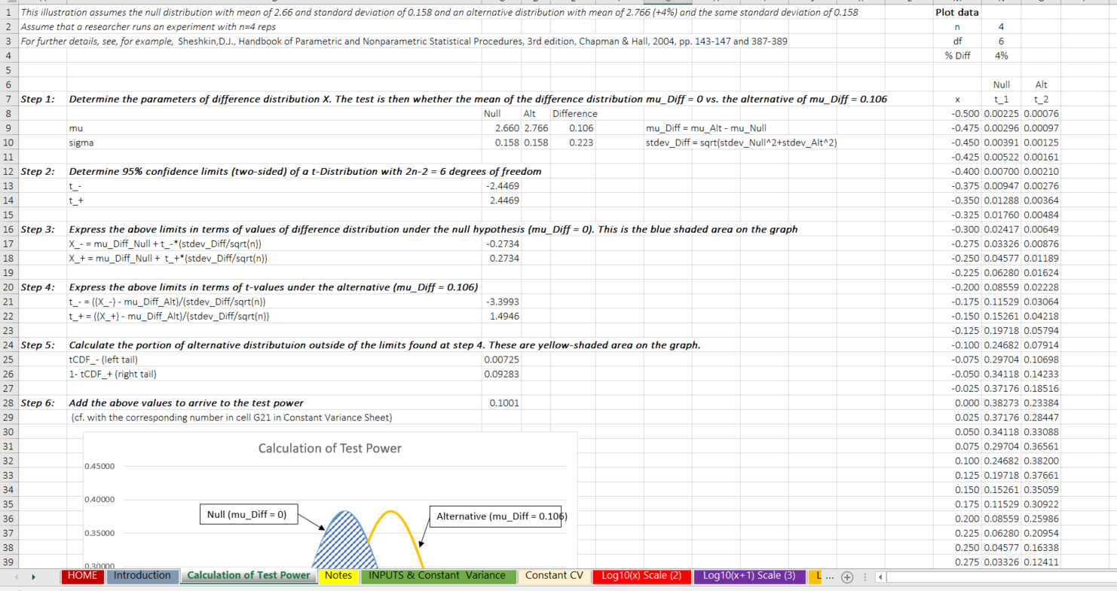
STEP 1 - Calculation of Test Power – For Example
Null distribution, mean of 2.66
Alternative distribution, mean of 2.766 (+4%)
SD of 0.158
Same SD of 0.158
Rep = 4

Slide 8
STEP 1 - Calculation of Test Power – For Example
Better Experimental Power
The results are different
at 5%

Slide 9
STEP 2 - NOTES
^{❶}The two sheets included in this workbook calculate power of a t-test based on two samples of size n Reps each when trying to separate two distributions with given means and variances (null and alternative)
^{❷}Both sheets allow the choice of % difference in means of the null and alternative distributions and baseline (null) standard deviation.
^{❸}The standard deviation of the alternative distribution is then calculated either based on constant CV (Constant CV sheet) or is set equal to that of null distribution (Constant Variance Sheet)
^{❹}The calculation of the test power consists of determining needs separating the area under the probability density function of alternative distribution outside of the bounds determining the 95% confidence interval of the null distribution (see explanation and figure above)

Slide 10
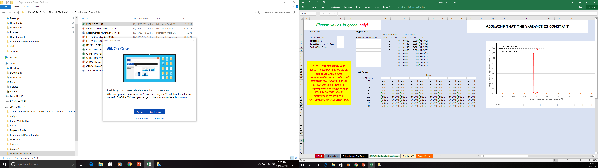
STEP 3 – Working with the E P G P — Inputs Data
^{❶}Open the program and after reading the instructions & Click on the worksheet

Slide 11
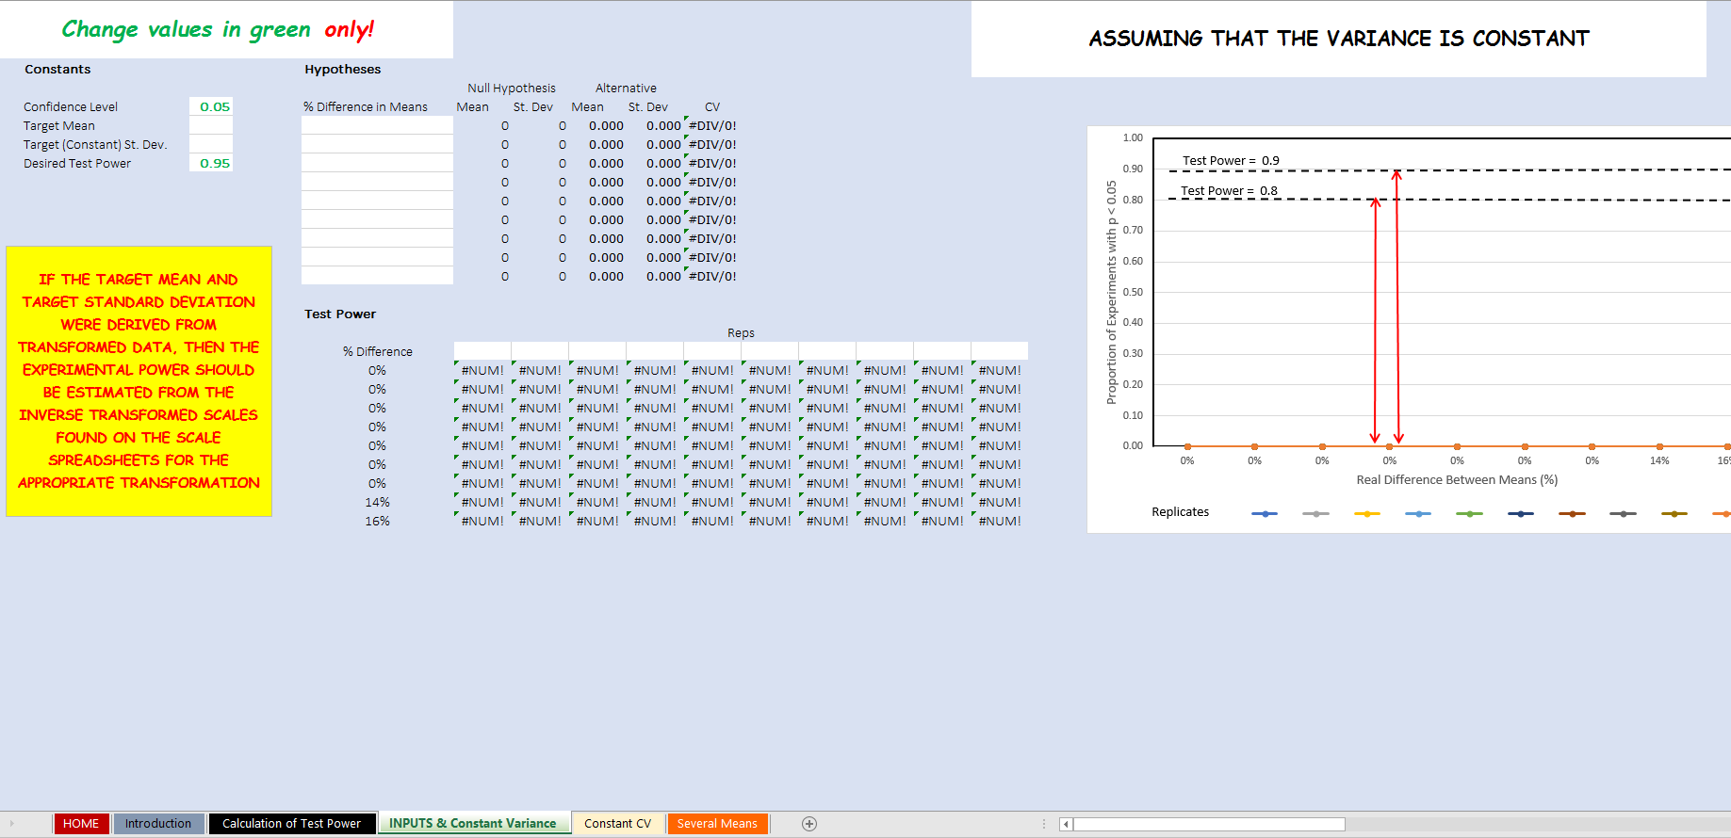
STEP 4 - Working the E P G P - Inputs data
Enter: Desired Test Power and Confidence Level
Confidence Level & Test Power = 1.00
These may vary:
0.01 – 0.99
0.05 – 0.95
0.10 – 0.90
“Depends on the rigor that the user wants”

Slide 12

STEP 5 - Working the E P G P - Inputs data
Enter – Mean and Standard Deviation
Data from What You Expect Based on History

Slide 13

STEP 6 - Working the E P G P - Inputs data
Enter: % Difference in Means

Slide 14
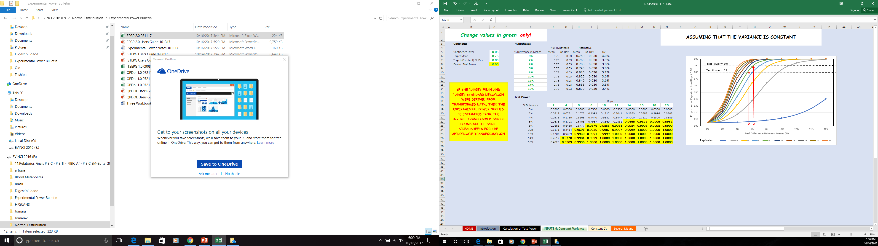
STEP 7 - Working the E P G P - Inputs data
Enter: Numbers Replicates
New lines appear in Graphics

Slide 15
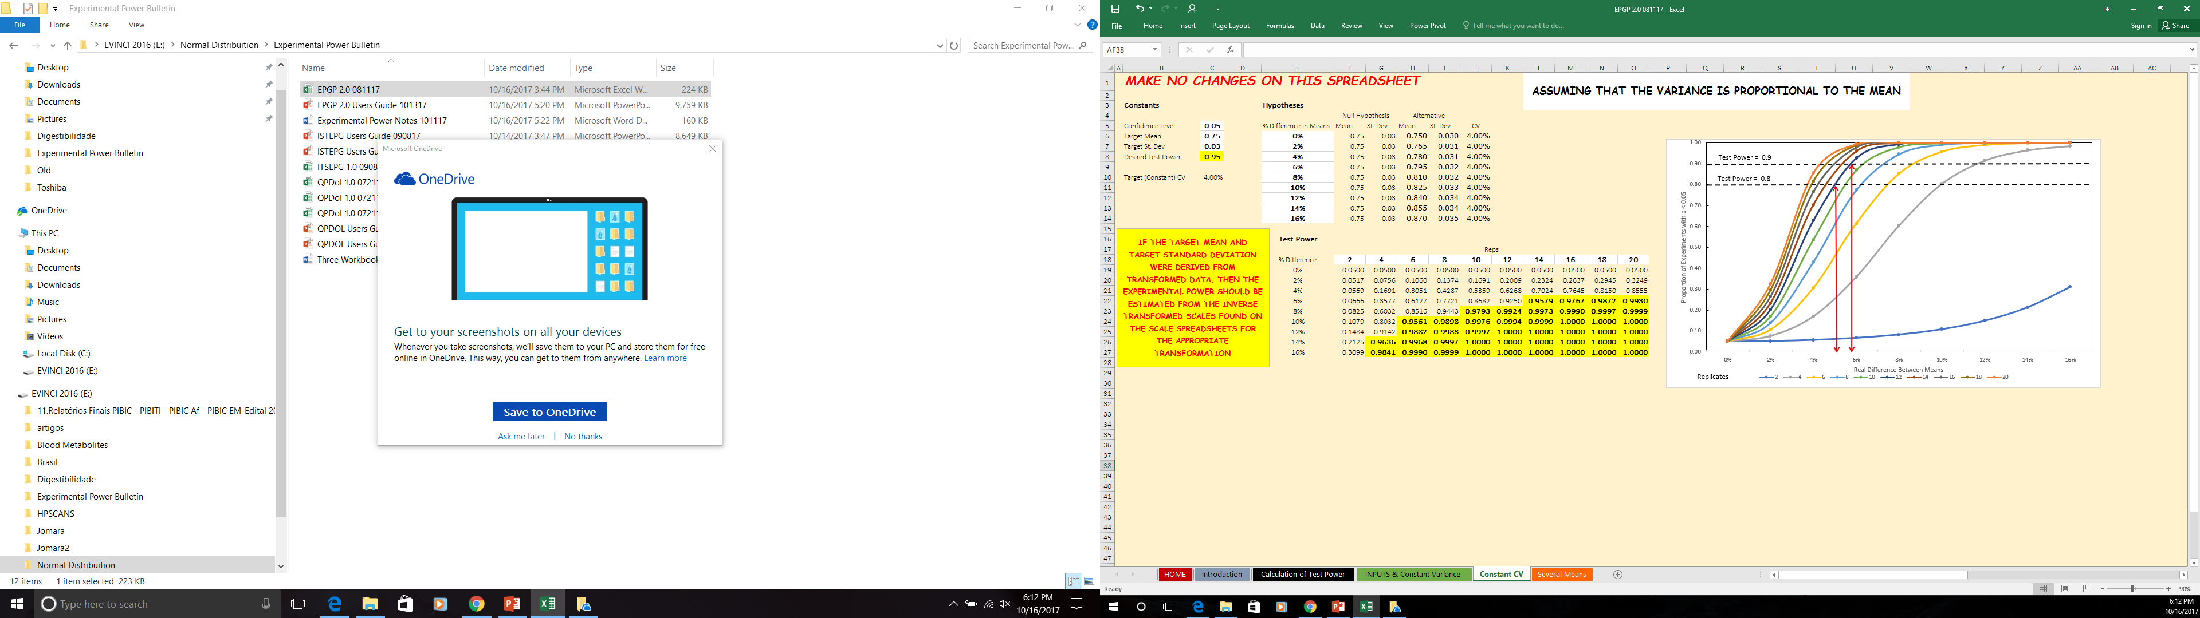
STEP 8 - Results
Constant Variance
Constant CV
Test Power Results: Highlighted in Yellow for Test Power ≥ 0.95

Slide 16
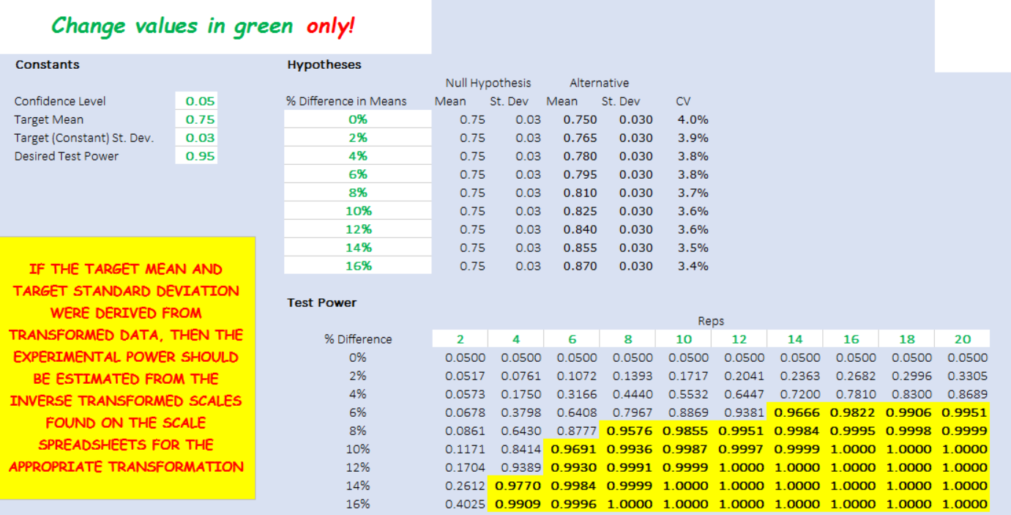
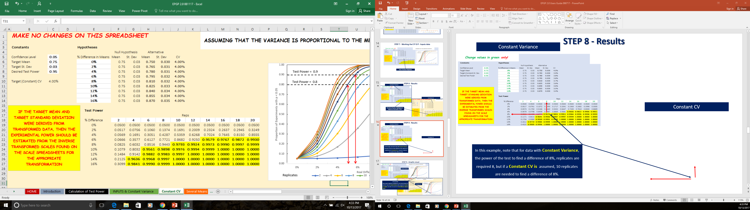
STEP 8 - Results
Constant Variance
Constant CV
In this example, note that for data with Constant Variance, the power of the test to find a difference of 8%, 8 replicates are required, but if a Constant CV is assumed, 10 replicates are needed to find a difference of 8%.

Slide 17
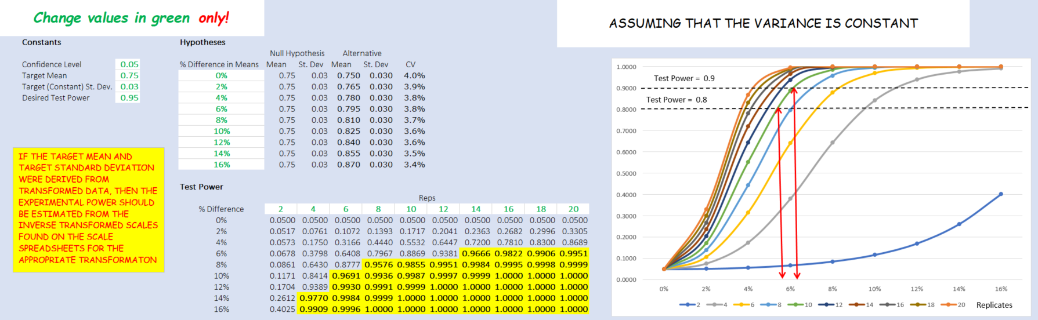
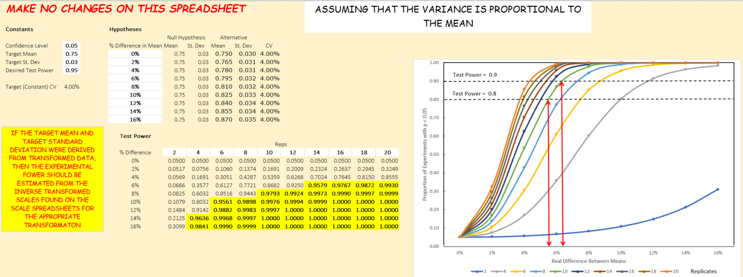
STEP 9 – Graphic visual
Constant Variance
In this example:
When using 10 replicates, the difference in Test Power between 0.8 and 0.9 is lower for Constant Variance when compared to Constant CV models, but both are near 6% of Real Difference Between Means.
Constant CV

Slide 18
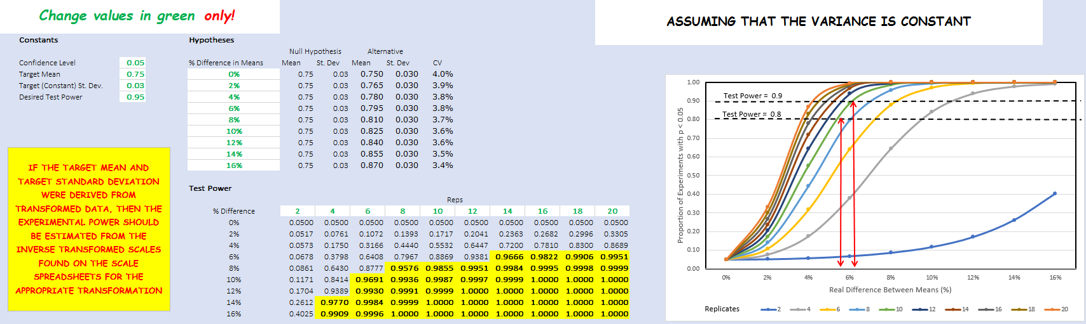
STEP 10 – New Test Power
Again - Change values in green, only
IMPORTANT
Other changes occur automatically
In Inputs & Constant Variance
Other changes occur automatically

Slide 19
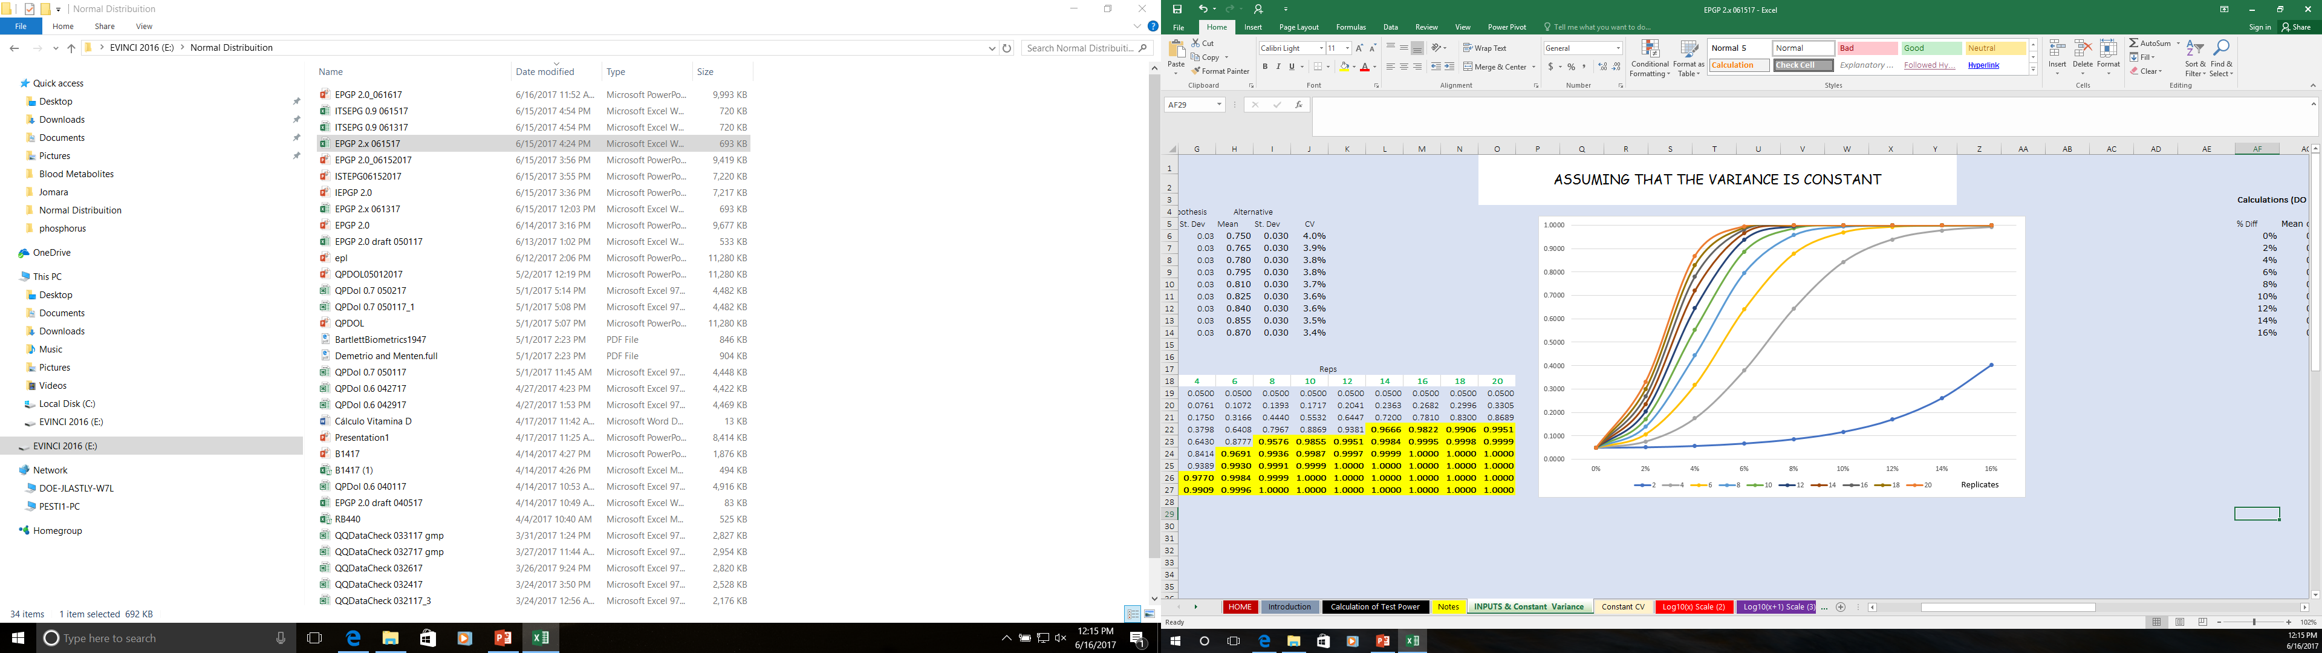
Experimental Power Concept
Usually presented as a single number:
  “The experiment could detect a real 6% difference 90% of the time (10 replicates)”
Test Power = 0,90 (90%)

Slide 20
Experimental Power Concept
More realistically represented by a line:
  “The experiment could detect a real 10% difference practically 100% of the time, a real 6% difference 90% of the time, and a real 4% difference about 55% of the time, etc. ”
0.5500

Slide 21
Experimental Power Concept
For experimental planning, the importance of technical and economic differences can be considered along with the cost of different numbers of replication:
  “Doubling the size (cost) of an experiment (replication) increases the chances of detecting a 6% difference from 80% (8 replicates) to nearly 100% (16 replications)”
EPGP Makes the Graphing Easy
“The interpretation may still be very difficult to comprehend”

Slide 22
Important points
^{❶} This workbook was designed for normally distributed data. The QPDOL.exe workbook may be helpful to determine if a transformation is needed to help normalize data for analysis and if so, ITSEPG should be helpful for graphing the inverse transformed data.
^{❷} A basic assumption of Analysis of Variance is that variances are equal. While it may not be possible to prove variances are not equal, it is sometimes obvious that variation increases proportionately to the mean. For instance, as birds grow, they become more variable. Therefore calculations in EPGP are produced for both constant absolute variation and constant coefficient of variation models.
^{❸} EPGP.xls is a planning tool. While it may be intuitive that having more replication improves the chances of finding statistically significant differences, in reality the determined p-value “is what it is.” Planning an experiment with a large number of replicates should not influence the determined p-value and should not be interpreted as doing so.

